Slide 1

INTRODUCTION TO
POWER BI

Slide 2
SPEAKERS
NANCY GUPTA
ALEESHA SINGH

Slide 3
CONTENTS
1) Introduction
2) Applications
3) Features of Power BI
4) Components of Power BI
5) Why use Power BI
6) Ways to use Power BI
7)Tableau vs Power BI
8) How to Download Power BI
9) Resources

Slide 4

WHAT WILL YOU LEARN?
The Basics of Power BI and it's Key Features
How To create interactive Dashboards and Reports

Slide 5

INTRODUCTION
Power BI is a business intelligence (BI) and data visualization tool developed by Microsoft. It allows users to connect to various data sources, transform raw data, and create interactive reports and dashboards.
Power BI is widely used for data analysis, reporting, and decision-making in businesses and organizations.

Slide 6


Power BI is ideal for anyone who needs to analyze data, create reports, and make data-driven decisions.
It is used across various industries and job roles:
1)Business Analyst and Data Analyst
2)Business Intelligence (BI) Professionals
3)Managers & decision makers
4)Finance and Accounting Professionals
5)IT Professionals and Developers

Slide 7

KEY FEATURES OF POWER BI
DATA CONNECTIVITY: Connects to multiple data sources like Excel, SQL server and cloud databases.
DATA TRANSFORMATION: Cleans and transforms data using Power Query.
VISUALIZATION : Creates interactive charts, graphs, and dashboards.
AI POWERED INSIGHTS:Uses artificial intelligence for advanced analytics.

Slide 8


COMPONENTS
POWER BI DESKTOP
POWER BI MOBILE
POWER BI SERVICE

Slide 9

WHY USE POWER BI
1) Ease of use
2) Integration
3) Real-time updates
4) Interactive dashboards
5) Data transformation
6) Advanced analytics
7) Affordable

Slide 10
WAYS TO USE POWER BI
1) Data Visualization
2) Data Integration
3) Business Analytics
4) Collaboration
5) Predictive Analytics & AI
6) Mobile Access

Slide 11
TABLEAU VS POWER BI
1) More complex, requires prior experience.
2) Expensive (subscription- based)
3) Limited AI Features
1)Easier for beginners with an intuitive interface
2)More affordable, offers a free version
3) Strong AI and Machine Learning capabilities.

Slide 12
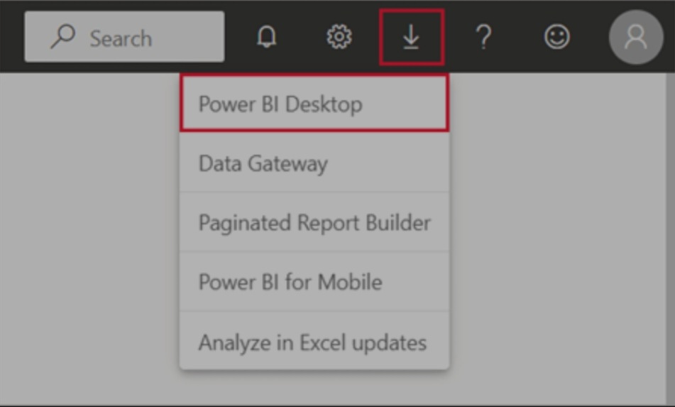
STEPS TO DOWNLOAD POWER BI
To download Power BI Desktop, go to the Power BI Desktop download page and select Download Free. Or for download options, select See download or language options.
You can also download Power BI Desktop from the Power BI service. Select the Download icon in the top menu bar, and then select Power BI Desktop.

Slide 13
ASSET HAVEN
1) TATA GROUP SIMULATION
2) TOP 10 TEMPLATES OF 2025
3) REPORT EXAMPLES
4) AVAILABLE DATASETS
5) TUTORIALS

Slide 14


Slide 15
THANK YOU!
FOR YOUR ATTENTION

